Slide 1

developing & deploying
large scale shiny applications
Herman Sontrop, PhD
Work: FRISS
Senior data scientist
Product owner
Team lead analytics team
Shiny & web development enthusiast
RSTUDIO::conf 2018, session 3, case-study
www.friss.eu/en

Slide 2
Shiny JavaScript tutorial series
6 in depth tutorials learning you:
the basics of HTML, CSS & JavaScript
How to create your own widgets
How to create a custom input binding
how to pass data & events from the client to shiny and back
Create an interactive dashboard from scratch with:
A set of custom C3.js HTMLwidgets
Brushed timeline data filtering
Intro.js interactive help system
https://shiny.rstudio.com/articles/js-build-widget.html
https://github.com/FrissAnalytics/shinyJsTutorials

Slide 3
About FRISS
RSTUDIO::conf 2018, session 3, case-study
www.friss.eu/en

Slide 4
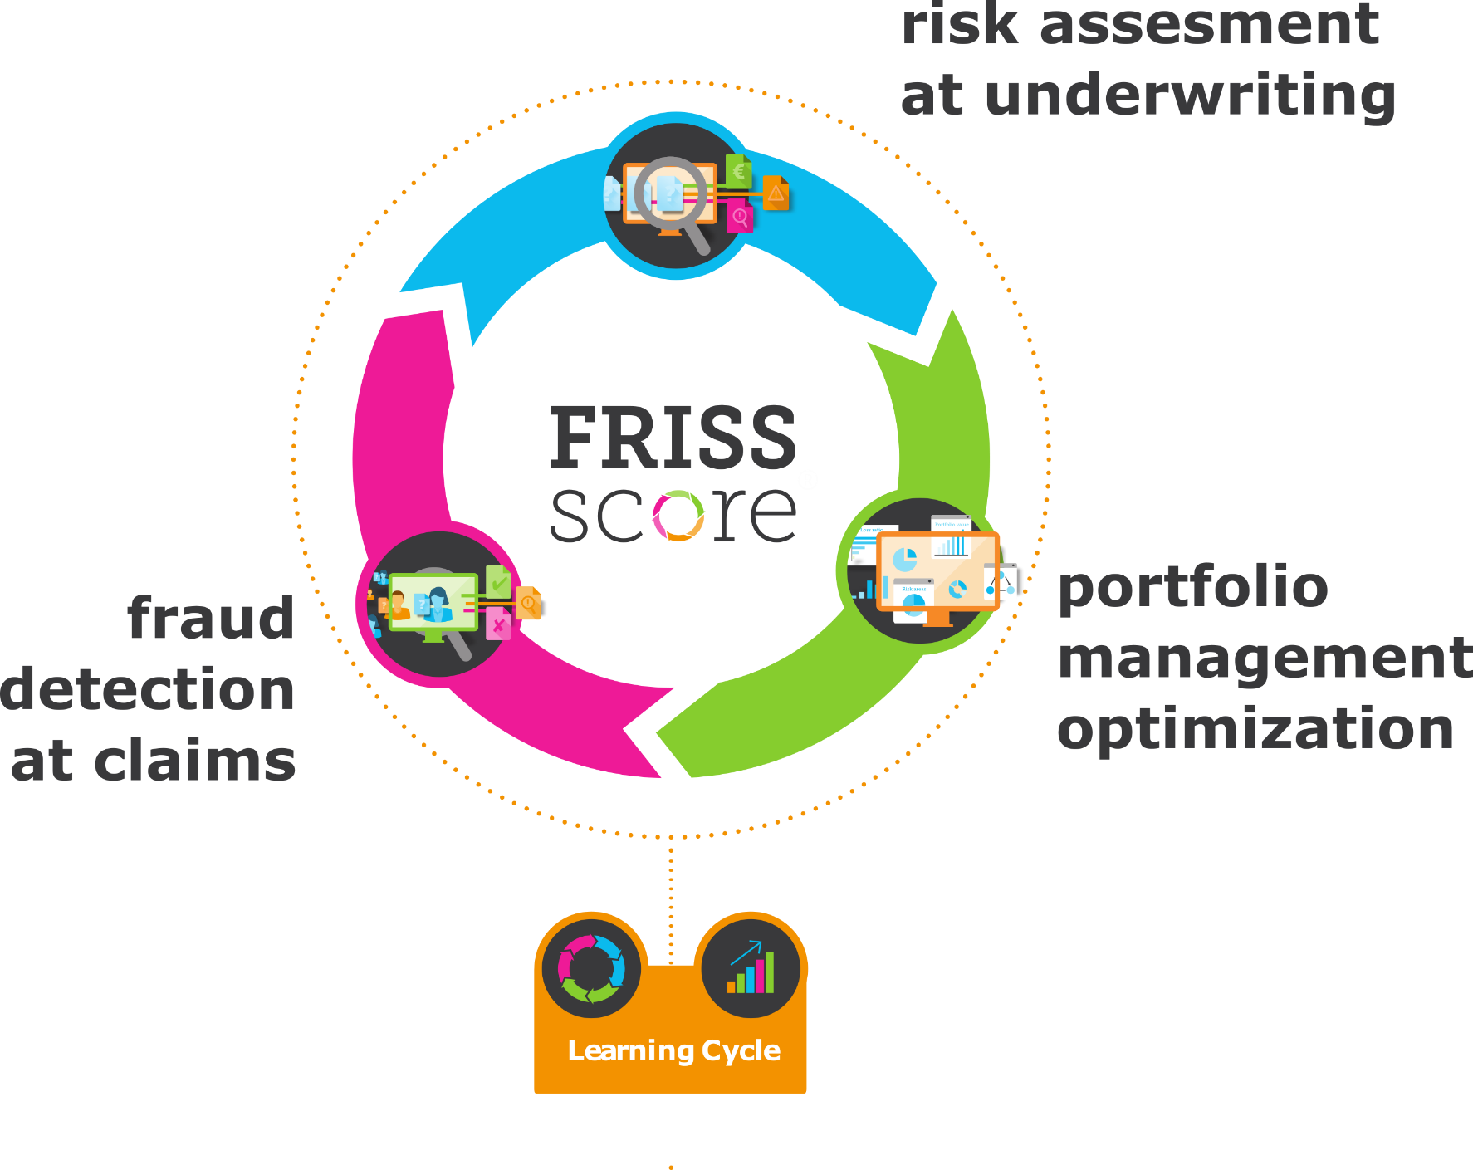
FRAUD
RISK
COMPLIANCE
focus on non-life insurance, European market leader, 100+ implementations world wide

Slide 5

example:
persons x applies online for car insurance at insurance company y
1
initial data
name
address
gender
date of birth
license plate
phone
bank account
…
input data

Slide 6
example:
persons x applies online for car insurance at insurance company y
1
2
initial data
enriched with external data
name
address
credit history
claim history
…
location info
gender
date of birth
license plate
phone
data source 1
data source 2
…
data source n
bank account
…
input data
automated data enrichment

Slide 7
example:
persons x applies online for car insurance at insurance company y
1
2
3
initial data
enriched with external data
AI engine
name
address
credit history
claim history
…
location info
statistical models
gender
date of birth
anomaly detection
license plate
phone
data source 1
data source 2
…
data source n
knowledge rules
bank account
…
network analysis
input data
automated data enrichment
scoring

Slide 8

example:
persons x applies online for car insurance at insurance company y
1
2
3
initial data
enriched with external data
AI engine
name
address
credit history
claim history
…
location info
statistical models
gender
date of birth
anomaly detection
license plate
phone
data source 1
data source 2
…
data source n
knowledge rules
bank account
…
network analysis
input data
automated data enrichment
scoring

Slide 9
…
name
license plate
address
bank account
phone
entity

Slide 10
time 1
…
claim 1
name
license plate
address
bank account
phone
entity
name
license plate
address
bank account
phone
entity

Slide 11
time 1
time 2
claim 1
claim 2
name
name
license plate
license plate
address
address
bank account
bank account
phone
phone
entity
entity
name
name
license plate
license plate
address
address
bank account
bank account
phone
phone
entity
entity

Slide 12
time 1
time 2
time 3
…
time t
claim 1
claim 2
claim 3
…
claim 5
name
name
name
…
name
license plate
license plate
license plate
…
license plate
address
address
address
…
address
bank account
bank account
bank account
…
bank account
phone
phone
phone
…
phone
entity
entity
entity
entity
entity
name
name
name
…
name
license plate
license plate
license plate
…
license plate
address
address
address
…
address
bank account
bank account
bank account
…
bank account
phone
phone
phone
…
phone
entity
entity
entity
entity
entity

Slide 13
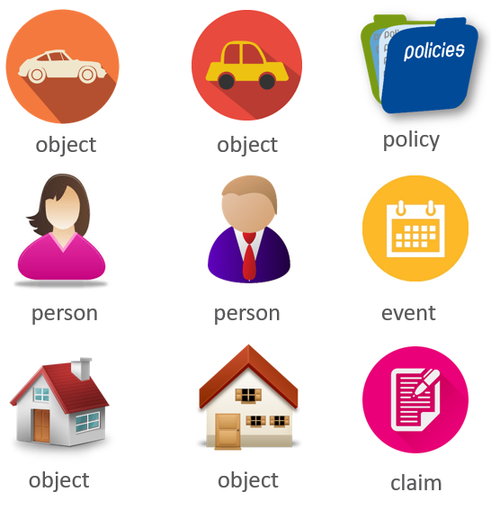
entity extraction

Slide 14




person B
crash 1
has
example fraud pattern
person A
shared phone number
12345
crash 2
has
person C
Entities (nodes) and their relations (edges) are modelled in a graph structure
that is mined for patterns & outliers

Slide 15
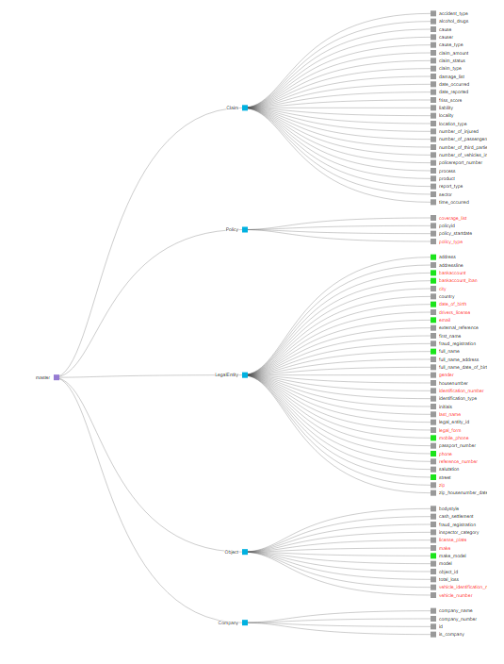

data model, data cleaning & data processing strategies are paramount for sensible analytics

Slide 16
R use cases in FRISS

Slide 17

Use case for R
pre-processing data
no user interface
1

Slide 18

Use case for R
pre-processing data
no user interface
1
interactive apps
user interface
2

Slide 19

Use case for R
pre-processing data
no user interface
1
interactive apps
user interface
2
live scoring engines
no user interface
3

Slide 20
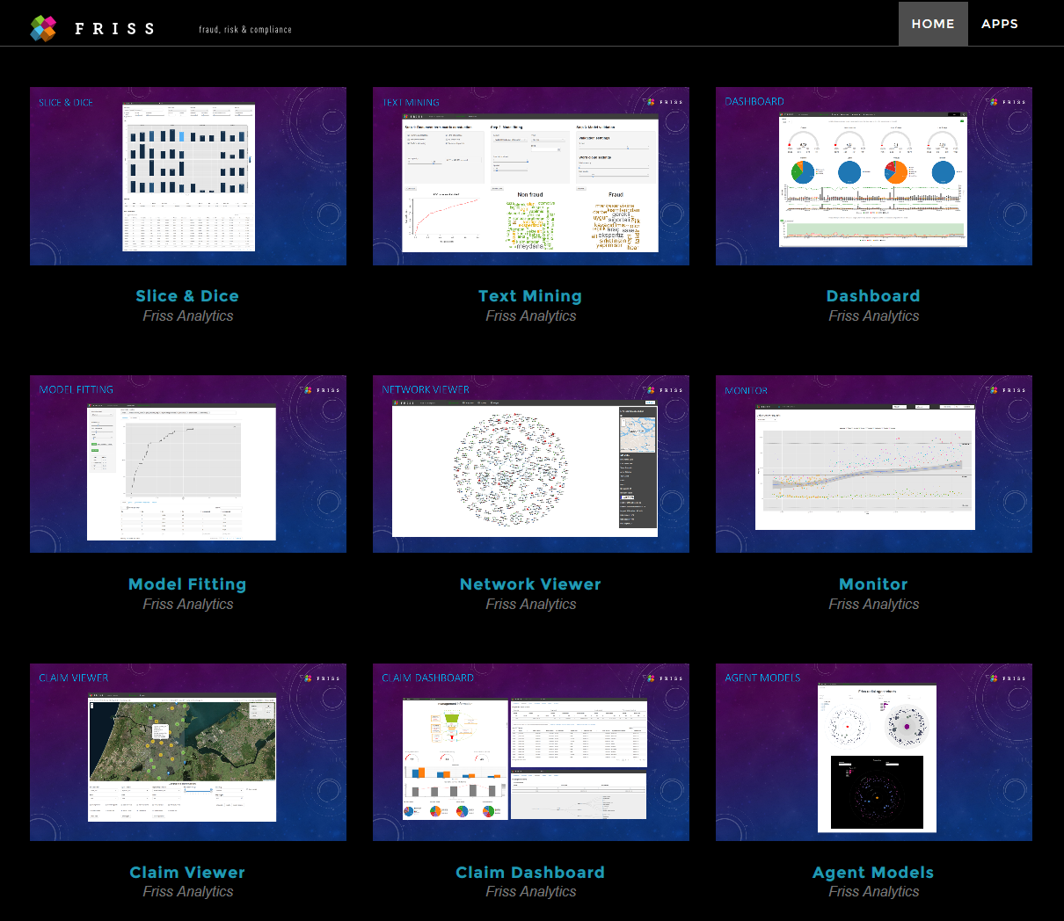
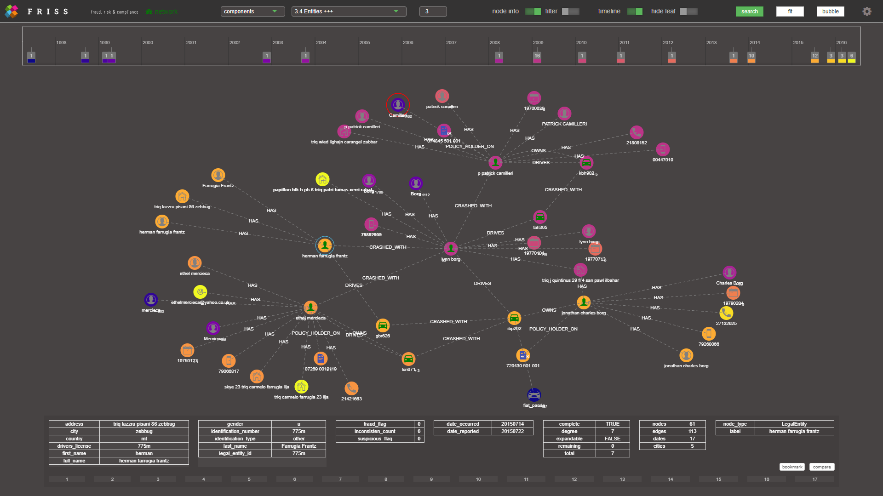

Slide 21
App building blocks & techniques

Slide 22
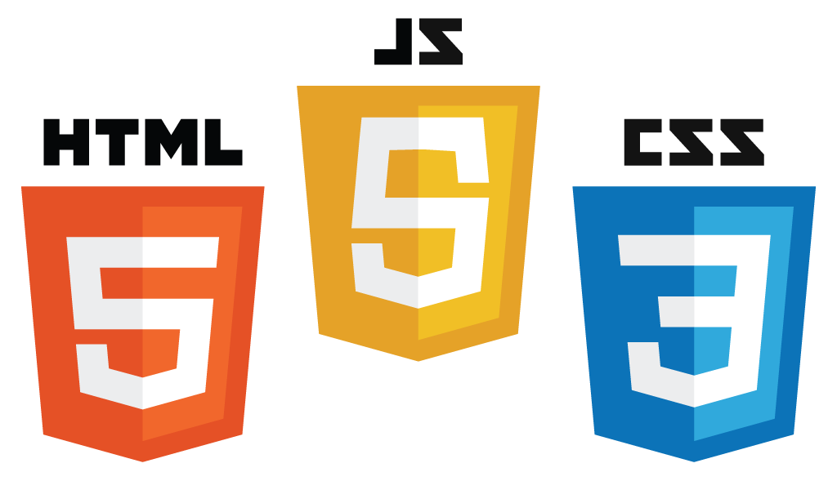


very useful to know the foundations of shiny & web development!

Slide 23



flexible JSON document storage & retrieval
advanced pattern matching for graphs
full text search
open source noSQL database engines provide enormous additional processing power

Slide 24
modules
R6 classes
HTMLwidgets
HTMLtemplates

Slide 25
Modules: separation of concerns
https://shiny.rstudio.com/articles/modules.html
module A
reactive input
ui
server
reactive output
example: data fetching
module B
reactive input
ui
server
reactive output
example: data visualization
Instead of creating a single, large app, create a set of smaller modules that each serve a special purpose and compose your main app using these modules

Slide 26

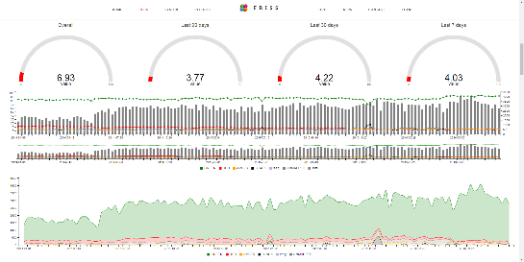
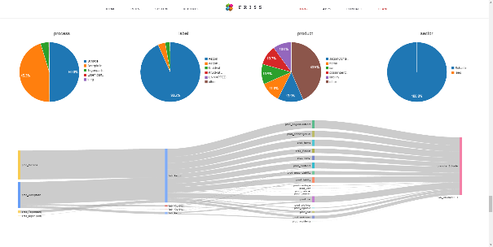
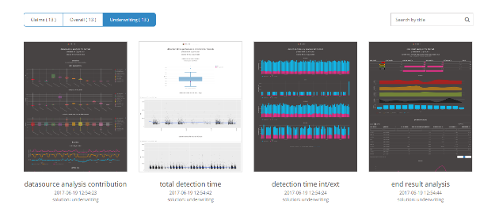
Module example
time interval
1
module x
data module
module y
2
3
module z

Slide 27
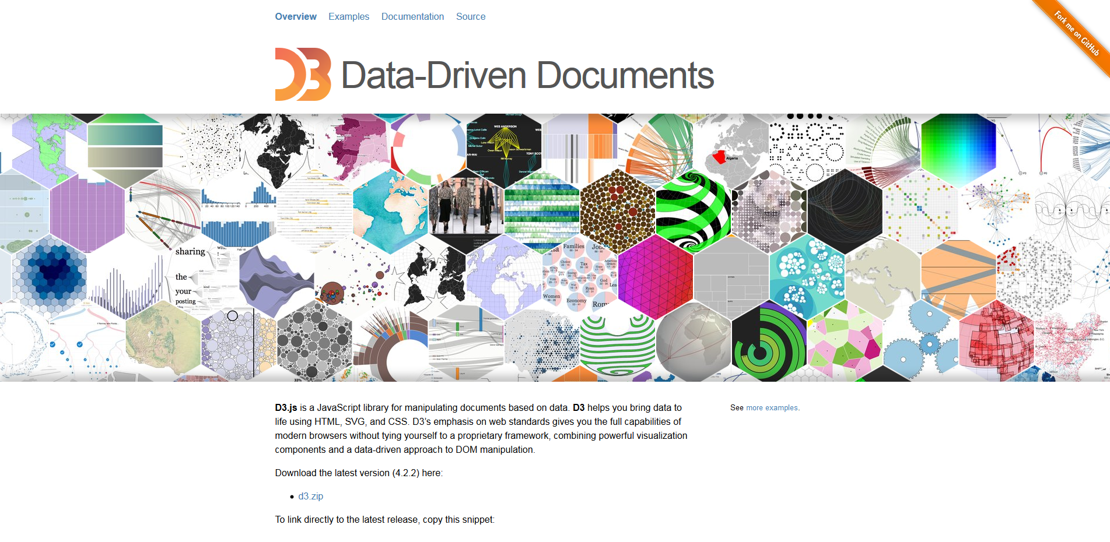
HTMLwidgets
http://www.htmlwidgets.org
Add the best of JavaScript to R!

Slide 28
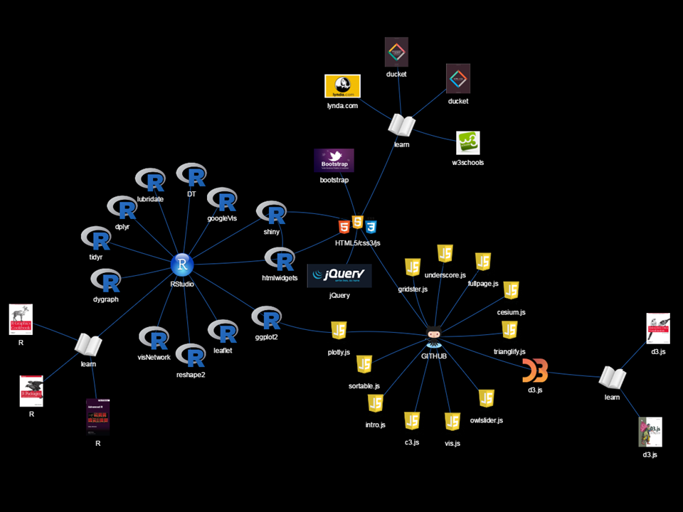

Slide 29
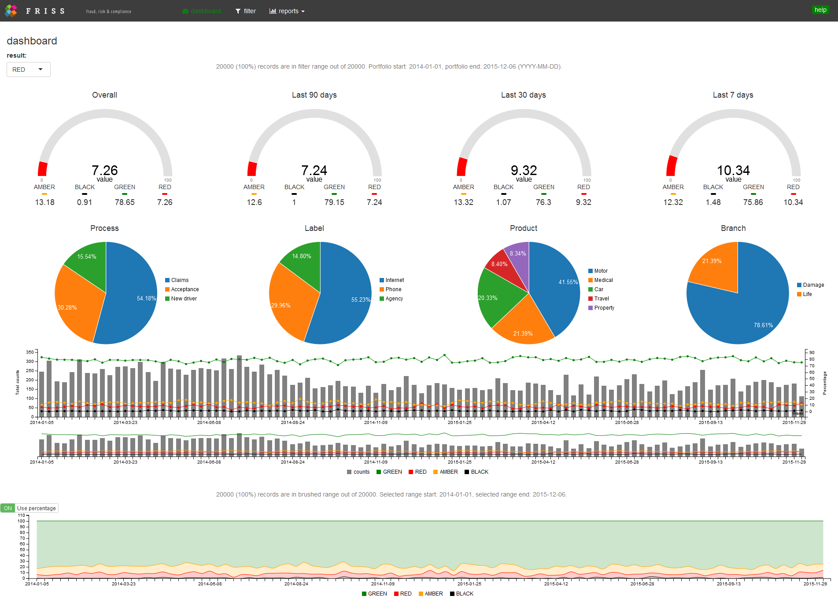
example dashboard with C3.js based HTMLwidgets

Slide 30
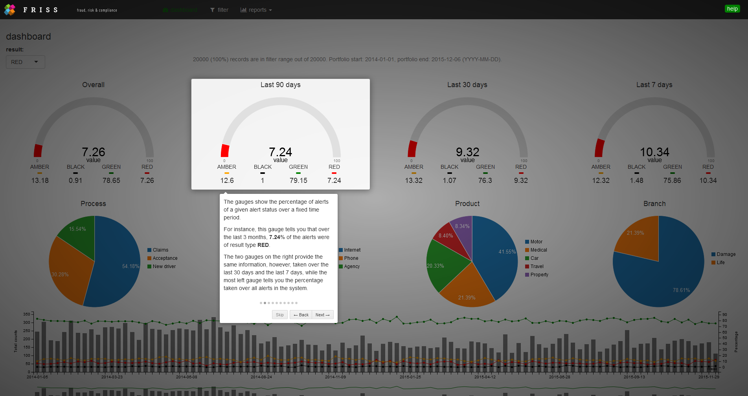
example: intro.js based interactive help system with animated boxes & highlighting

Slide 31
Demo 1: dashboard toy app
Custom HTMLwidgets + modules + interactive data filtering
https://shiny.rstudio.com/articles/js-build-widget.html
https://github.com/FrissAnalytics/shinyJsTutorials

Slide 32
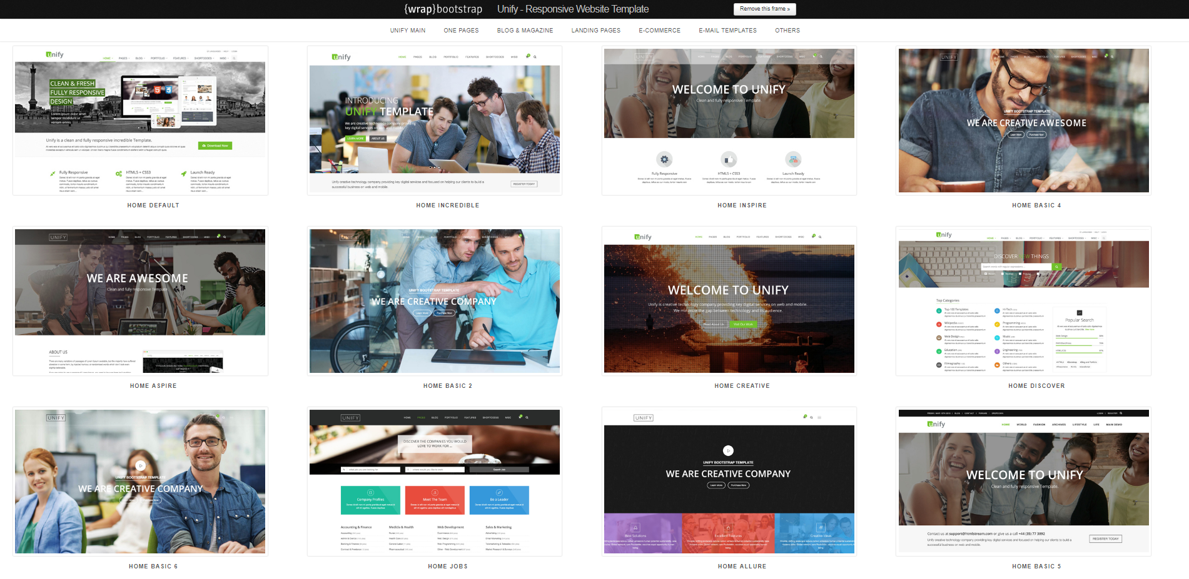
HTMLtemplates
https://shiny.rstudio.com/articles/templates.html
typical shiny: create UI + server logic via R, optionally add some HTML, CSS & JavaScript
more hardcore : start from raw HTML, CSS & JavaScript, add some R

Slide 33

markdown reports & webshot
pre-generated markdown reports, with thumbnails created via webshot visualized via HTMLTemplate using Cubeportfolio jQuery plugin

Slide 34
Demo 2: reports launch app
basic FRISS system performance metrics
pre-generated markdown reports
thumbnails created via webshot
thumbnails visualized via Cubeportfolio jQuery plugin
RSTUDIO tutorial:
https://shiny.rstudio.com/articles/templates.html
* demo uses paid unify bootstrap theme, code not available

Slide 35
R6 classes: encapsulated data & related functions
Person <- R6Class("Person",
public = list(
name = NULL,
hair = NULL,
initialize = function(name = NA, hair = NA) {
self$name <- name
self$hair <- hair
self$greet()
},
set_hair = function(val) {
self$hair <- val
},
greet = function() {
cat(paste("Hello", self$name))
}
)
)
example: state management without reactivity

Slide 36
Demo 3: network viewer
HTMLwidgets:
vis.js custom timeline
vis/js igraph / force layout graph visualization - visNetwork
JavaScript:
modules to control front end [no need for client – server – client trips]
twitter type ahead jQuery plugin
Neo4j: connected components + fraud patterns via
Elasticsearch: fuzzy full text search engine
MongoDB for entity resolution + node detail storage & retrieval
* code not available

Slide 37








Deployment
1
Version control
2
CI Build
3
Container registry
Developer
Development
4
8
Prod deployment
7
Staging deployment
6
Test deployment
5
User
Production
Non-production
Tester

Slide 38
Runtime
Sql
batch
pre-processor
3
Auth
Apache proxy
Elastic
MongoDB
Neo4j
.RData
User x
Shiny App 1 Tenant x
Shiny App 2 Tenant x
Shiny App 1 Tenant y
Shiny App 2 Tenant y
5
Redirect
Shiny App 1 Tenant z
Shiny App 2 Tenant z
2
Request
User y
1
Register
Consul cluster
User z
4
Resolve
Consul node
Consul node
Consul node
Service Discovery and Configuration

Slide 39
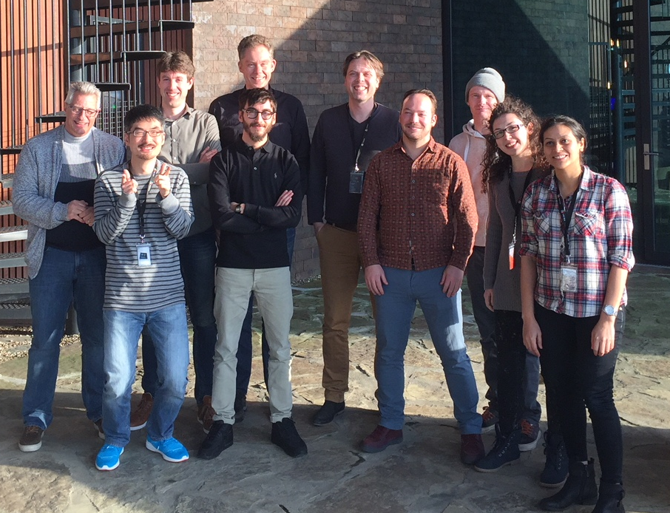
Danny
Herman
Gertjan
Erwin
Sabrina
analytics team
Rick
Gian
Waldo
Henry
Swathi

Slide 40
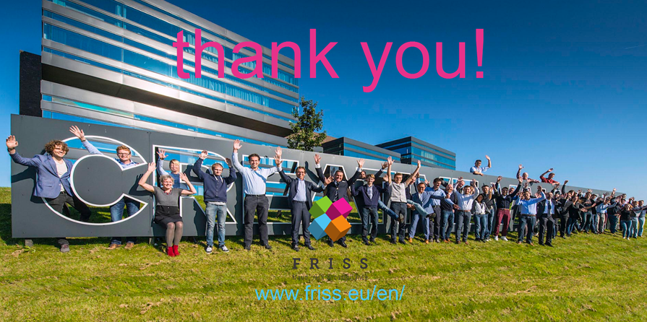

Slide 41
Shiny JavaScript tutorial series
6 in depth tutorials learning you:
the basics of HTML, CSS & JavaScript
How to create your own widgets
How to create a custom input binding
how to pass data & events from the client to shiny and back
Create an interactive dashboard from scratch with:
A set of custom C3.js HTMLwidgets
Brushed timeline data filtering
Intro.js interactive help system
https://shiny.rstudio.com/articles/js-build-widget.html
https://github.com/FrissAnalytics/shinyJsTutorials

Slide 42
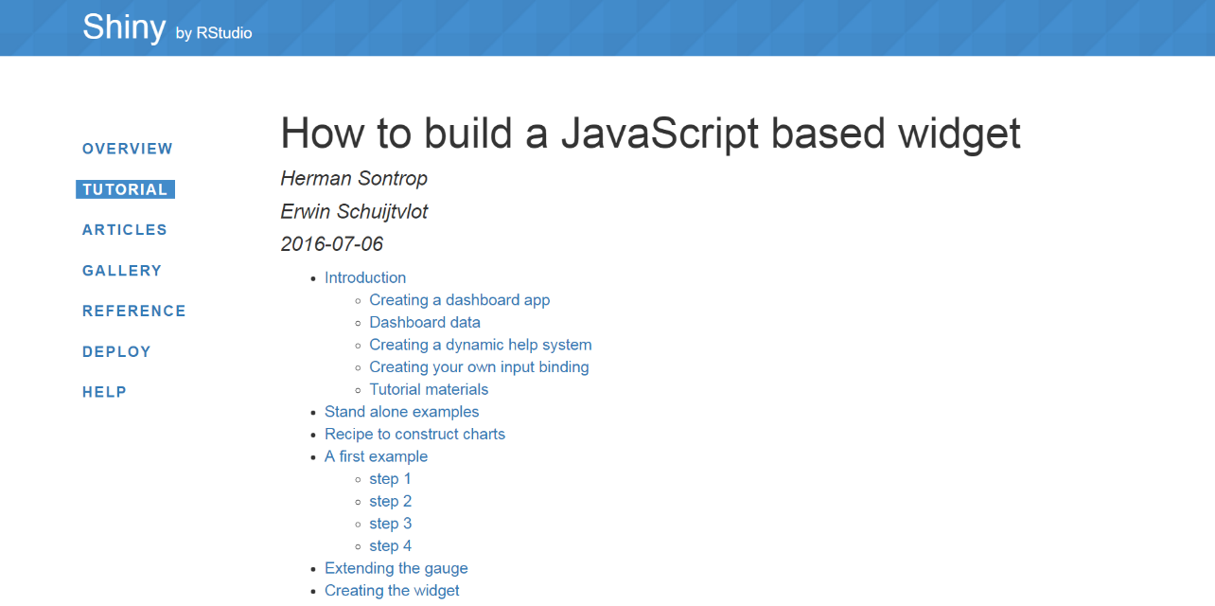

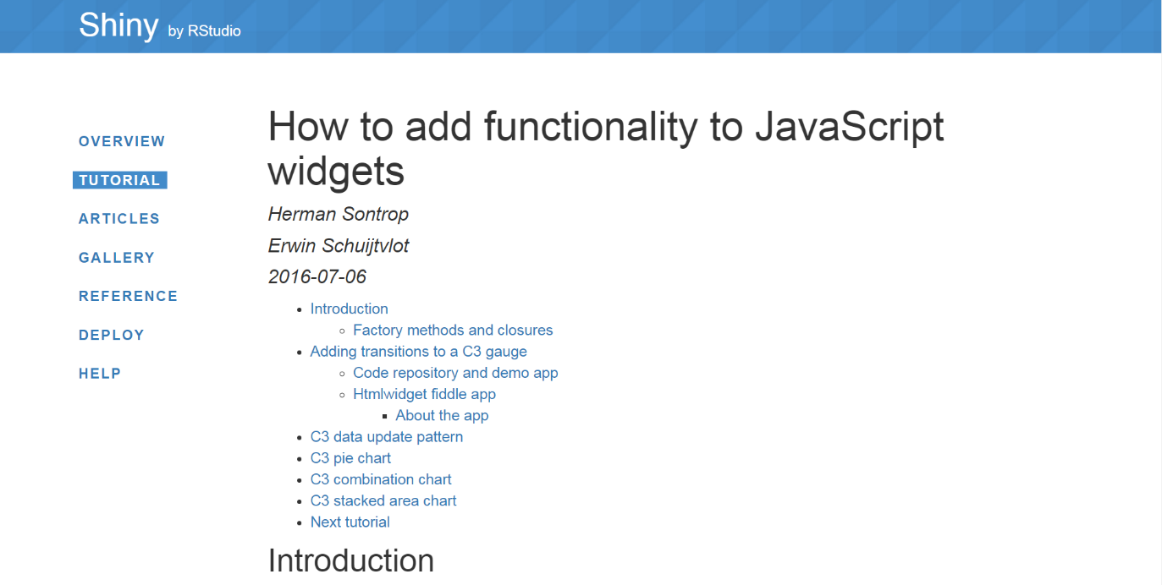

https://github.com/FrissAnalytics/shinyJsTutorials
http://shiny.rstudio.com/tutorial/

Slide 43
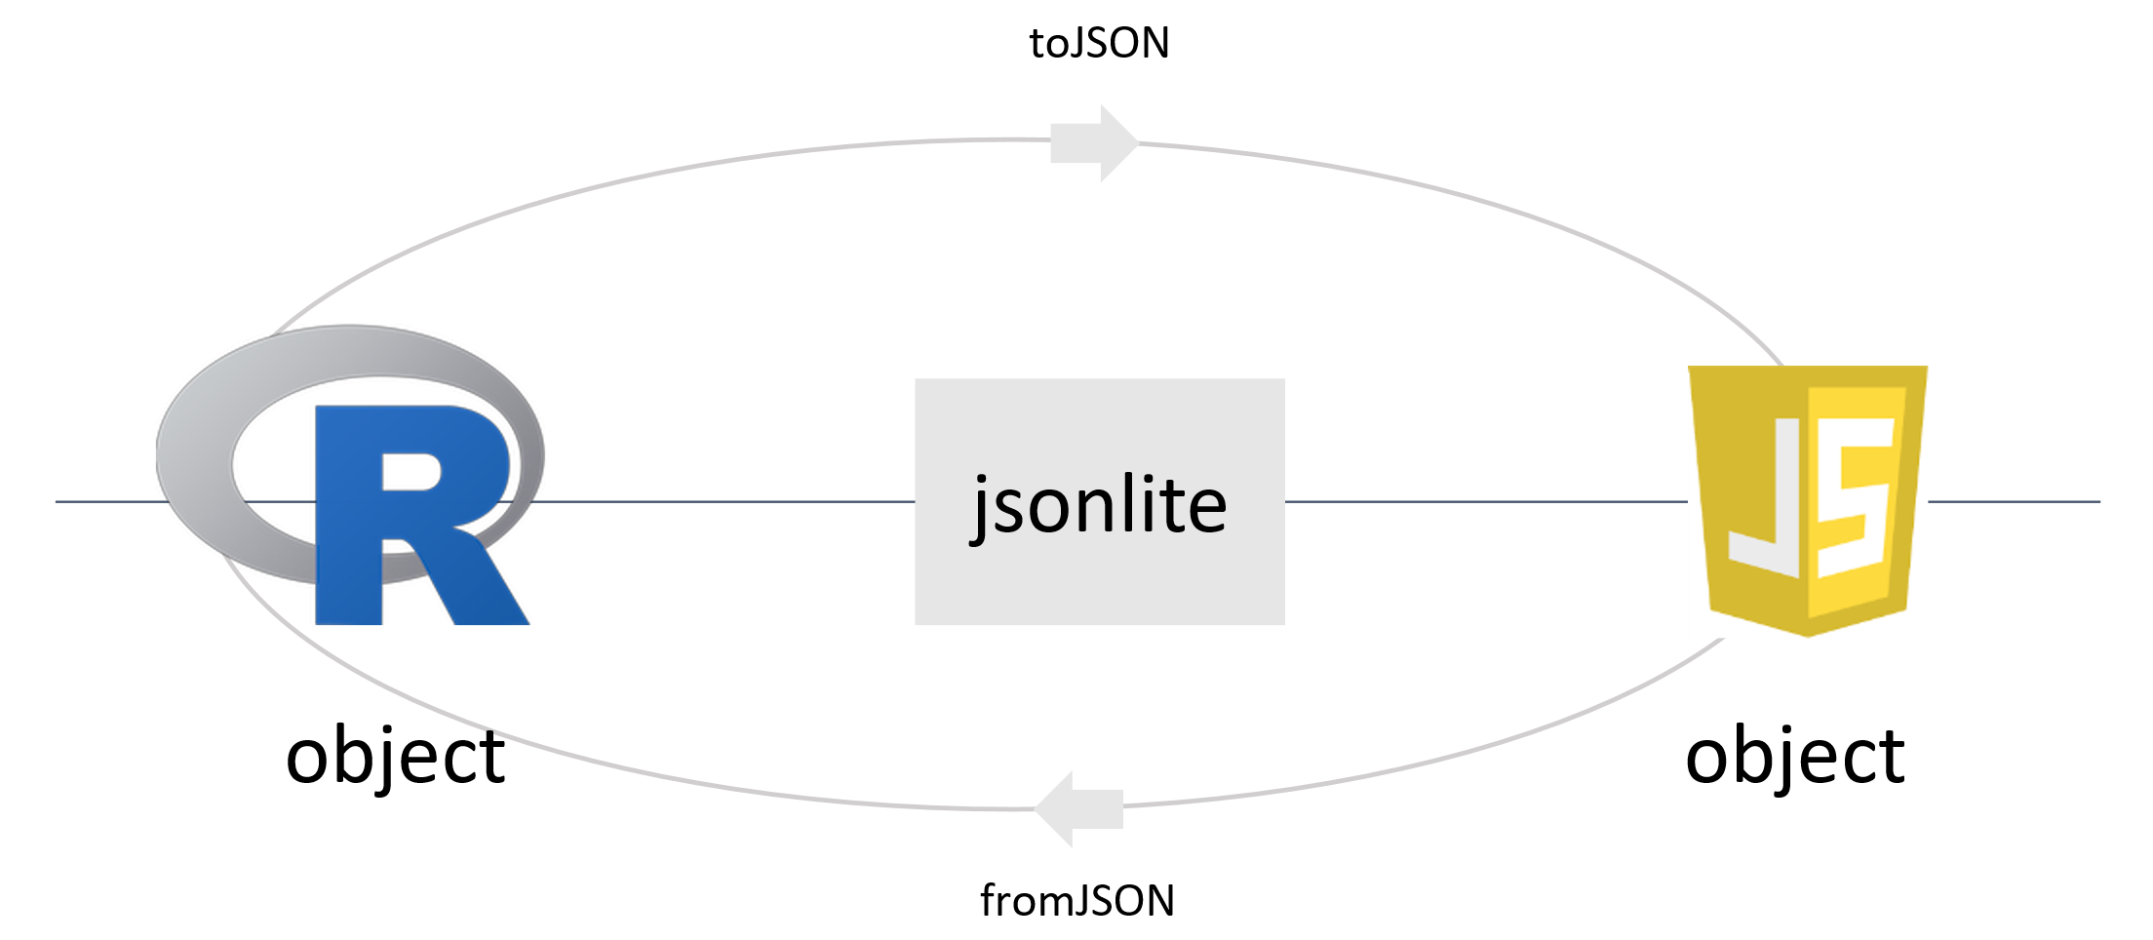

Slide 44
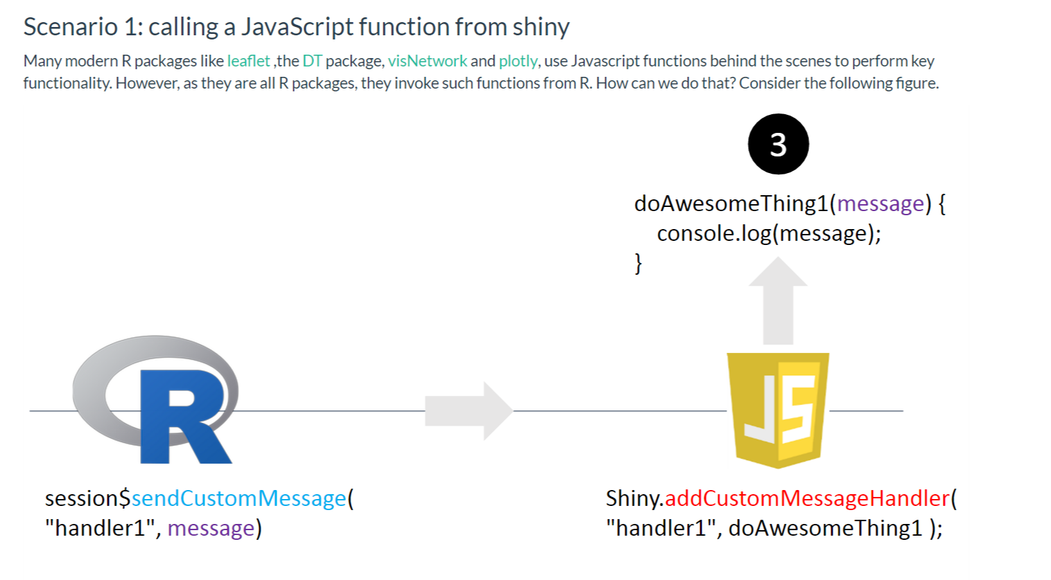
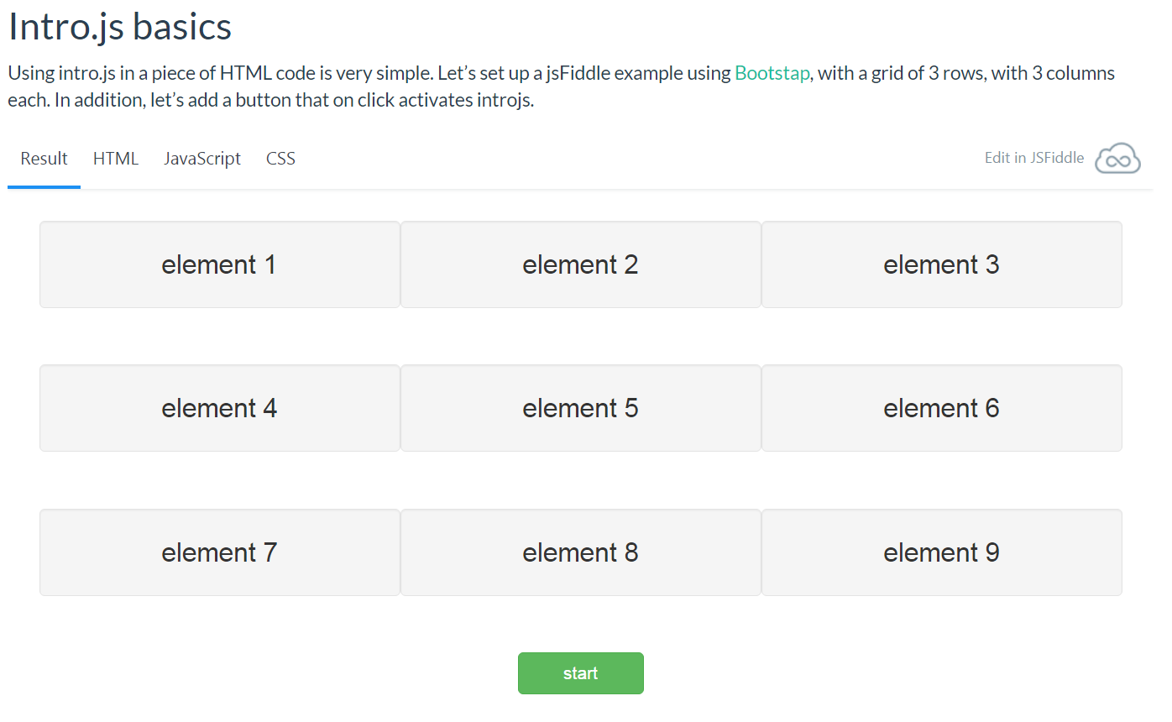
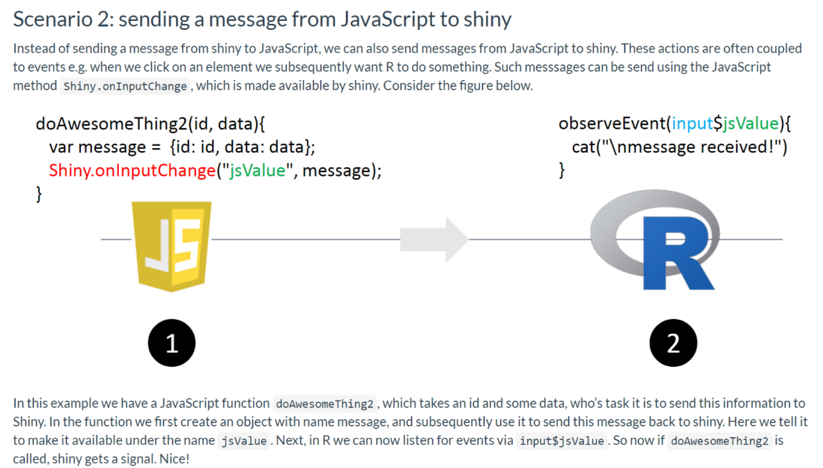
http://shiny.rstudio.com/tutorial/

Slide 45
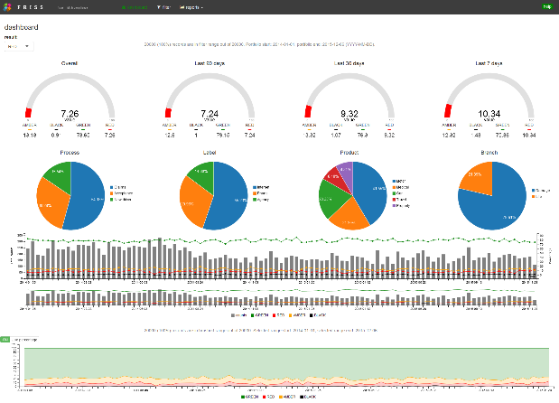


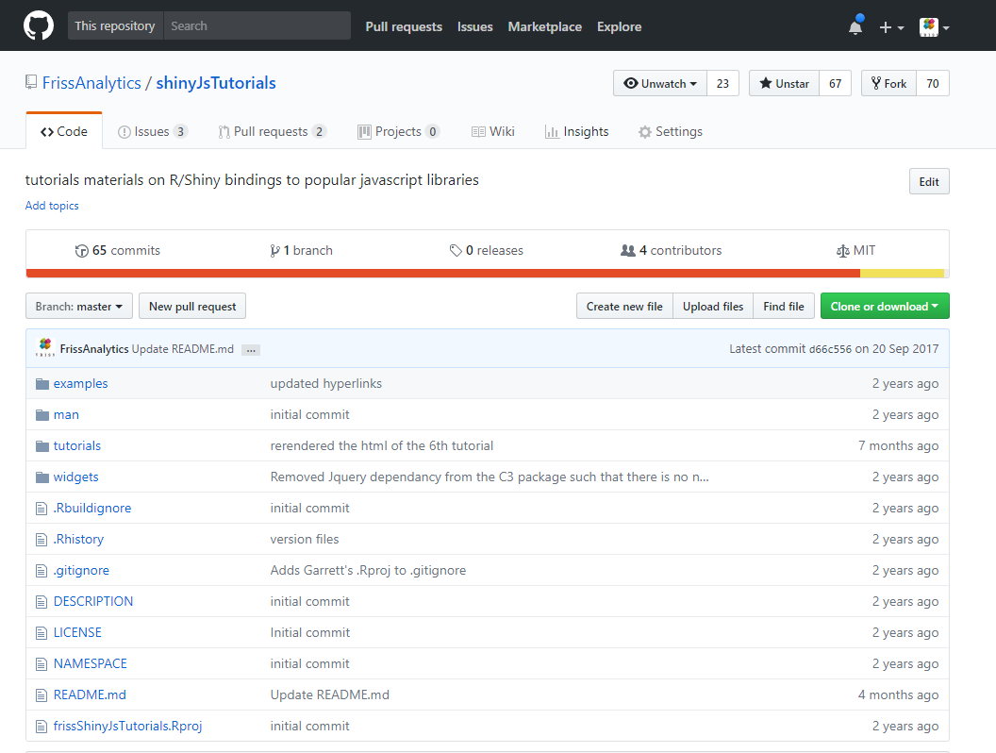
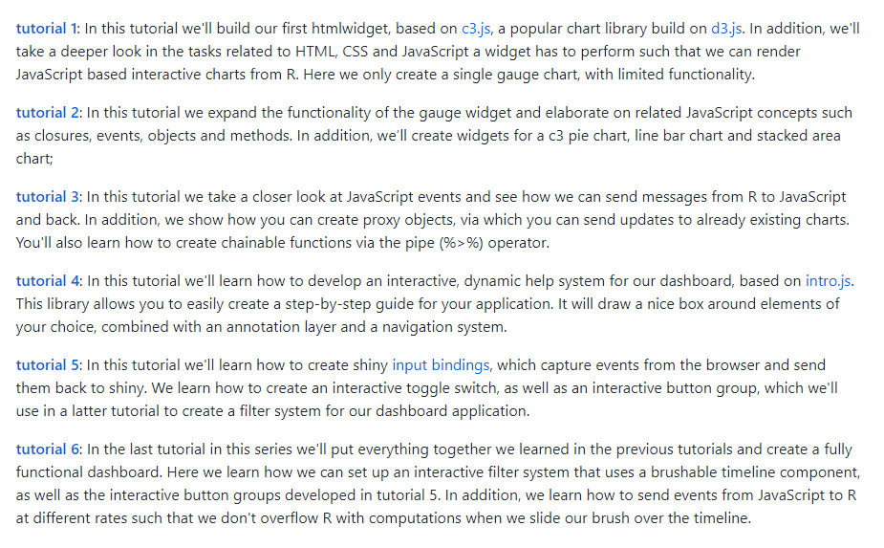
https://github.com/FrissAnalytics/shinyJsTutorials
http://shiny.rstudio.com/tutorial/

Slide 46
Questions?
https://github.com/FrissAnalytics/RSTUDIO-conf-2018

Slide 47
Links
Modularizing Shiny app code
https://shiny.rstudio.com/articles/modules.html
HTMLTemplates
https://shiny.rstudio.com/articles/templates.html
Book: Duckett, HTML + CSS
http://www.htmlandcssbook.com/
Book: Duckett, JavaScript + jQuery
http://javascriptbook.com/
HTMLWidgets
http://www.htmlwidgets.org/
https://shiny.rstudio.com/tutorial/js-lesson1/
https://github.com/FrissAnalytics/shinyJsTutorials
D3.js
https://d3js.org/
http://alignedleft.com/work/d3-book
https://www.manning.com/books/d3js-in-action-second-edition
Bootstrap
http://getbootstrap.com/
jQuery
https://jquery.com/
C3.js
http://c3js.org/
Vis.js
http://visjs.org/
VisNetwork
dataknowledge.github.io/visNetwork/
Timevis
https://github.com/daattali/timevis
ShinyJS
http://deanattali.com/shinyjs/
Unify - Responsive Website Template
https://wrapbootstrap.com/search?q=unify
OpenCPU
https://www.opencpu.org/
Docker
https://www.docker.com/
Team foundation server
https://www.visualstudio.com/tfs/
Octopus, automated deployment
https://octopus.com/
Consul, service discovery
https://www.consul.io/
Neo4j, NoSQL graph database
https://neo4j.com/
Elastic, NoSQL search database
https://www.elastic.co/
MongoDB, NoSQL JSON document storage
https://www.mongodb.com/

